Slide 1
The Dynasties
By Sam Seid

Slide 2
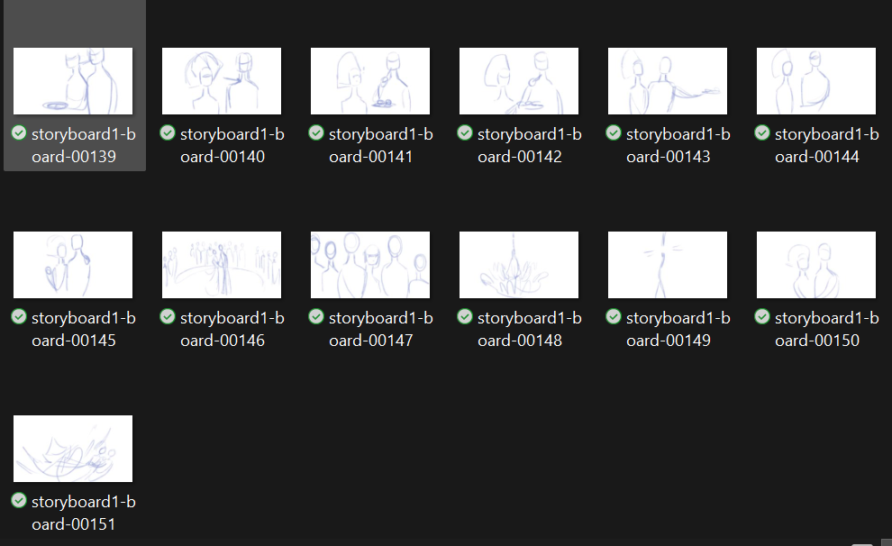
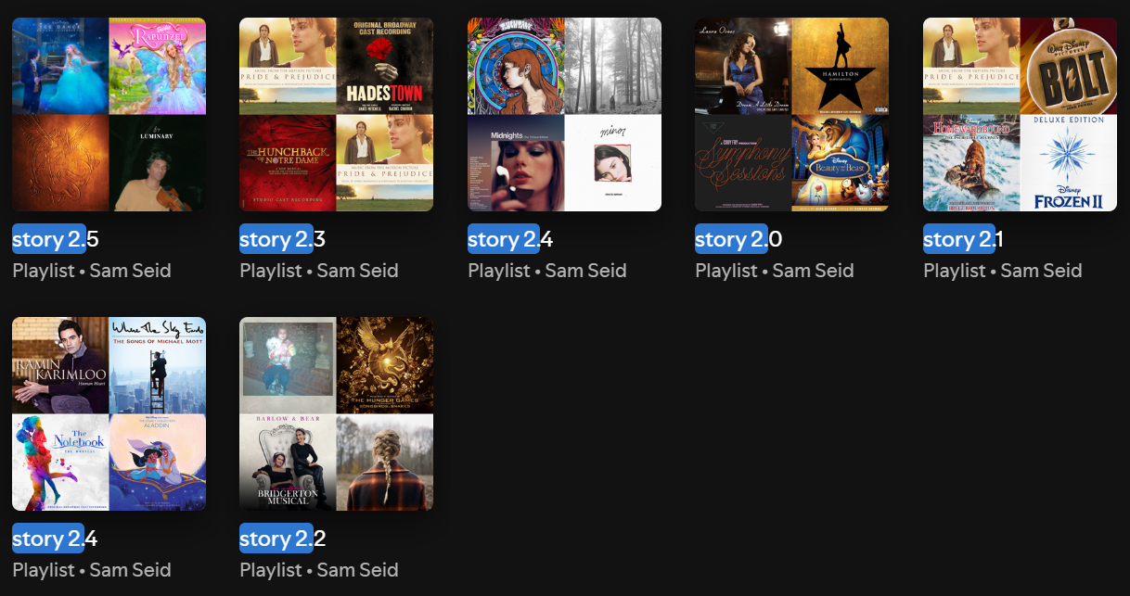
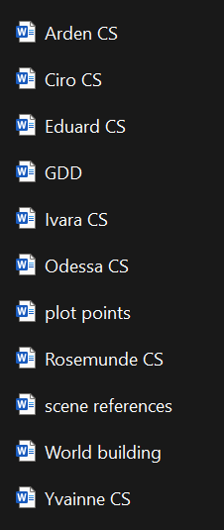
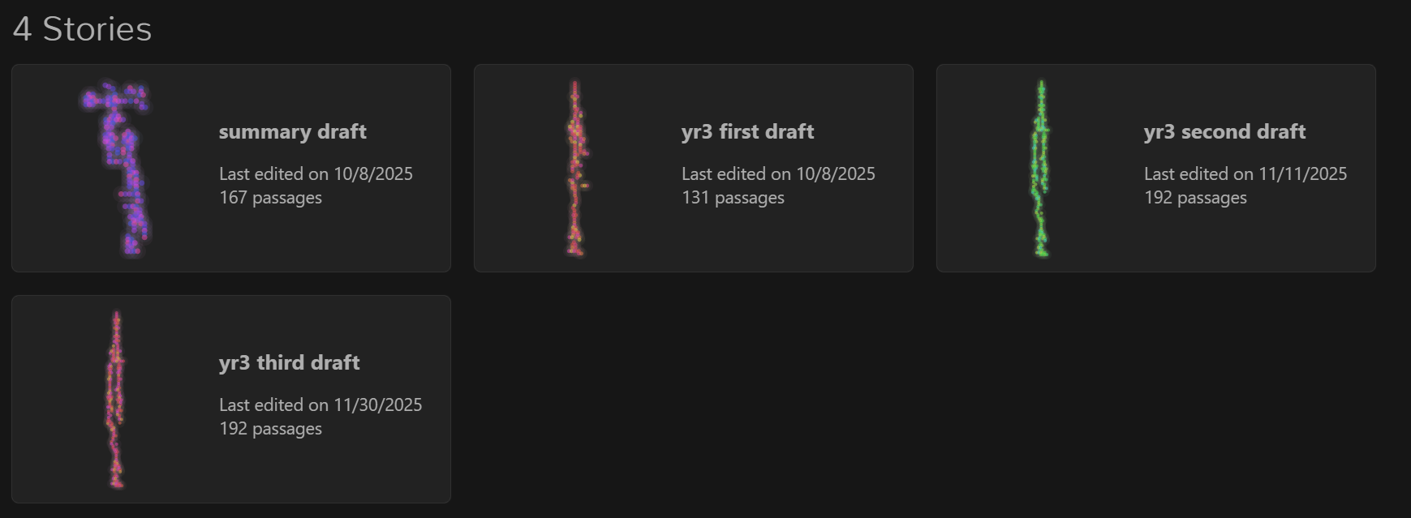
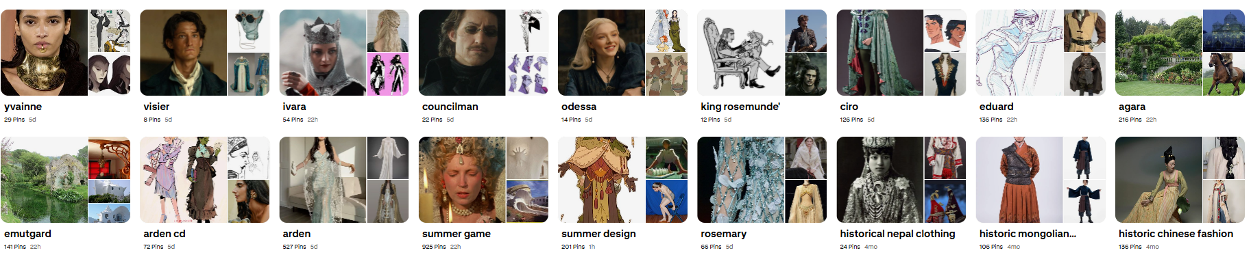
Notes:
Over 187 drawings for storyboard, 11 word documents, 7 playlists, 18 pinterest boards, 38 pages of planning, 4 twine stories

Slide 3
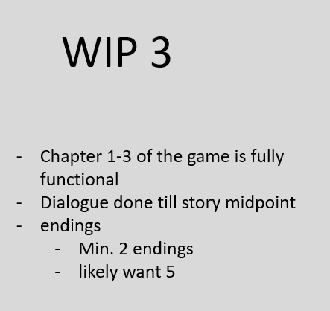

Slide 4
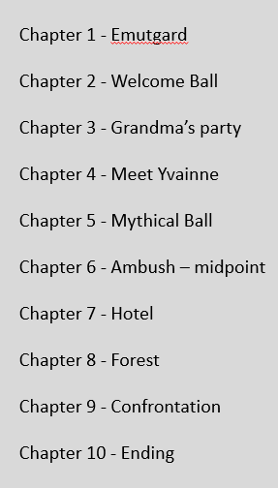
Chapter 1 – Meet Emutgard
Chapter 2 – Meet Agara
Chapter 3 – Arrive at Agara + ball
Chapter 4 – Tests and meet Yvainne
Chapter 5 – Grandma’s party
Chapter 6 – Library or Town
Chapter 7 – Mythical Ball
Chapter 8 – Ambush
Chapter 9 – Hotel
Chapter 10 – Forest
Chapter 11 – Confront or Don’t
Chapter 12 - Ending

Slide 5
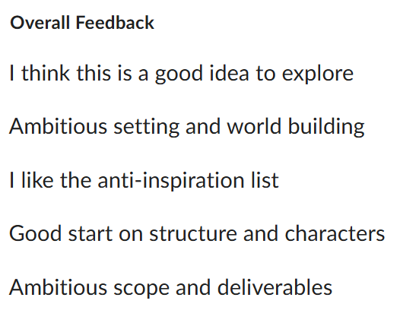
How do you think this project successfully highlights your professional skills and abilities?
Max’s Notes:
Met all work in progresses
A lot of progress
A lot of documentation
Mix of art, dialogue, and world-building
Still want to develop the game!

Slide 6
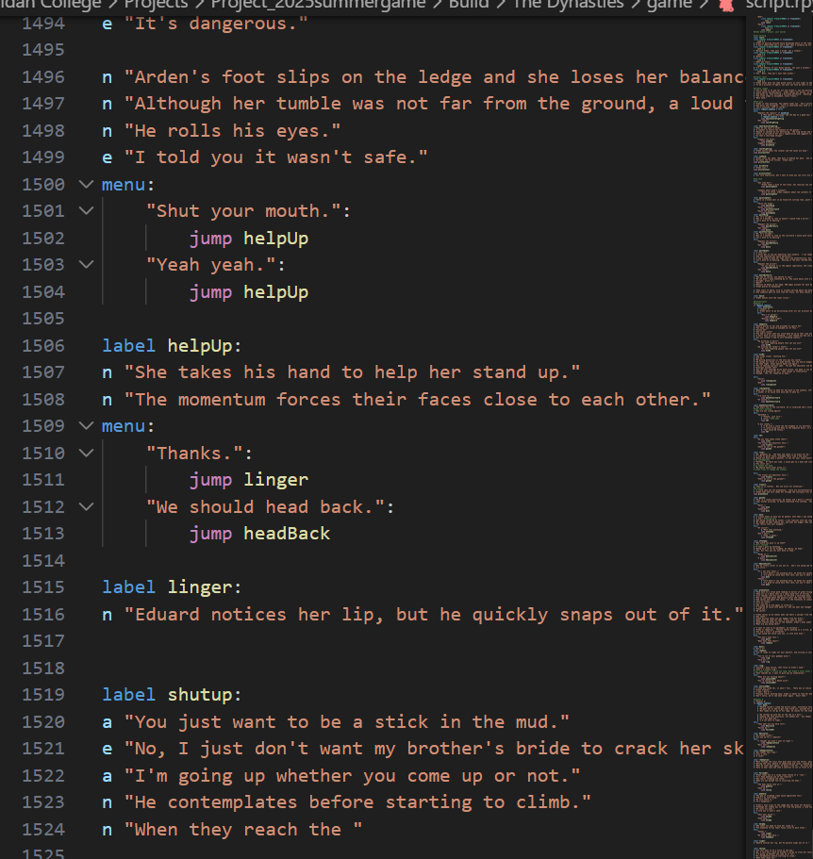
What went well during the development of this project? Is there one aspect you are particularly proud of?
- Very proud of amount of writing I could do in short amount of time

Slide 7
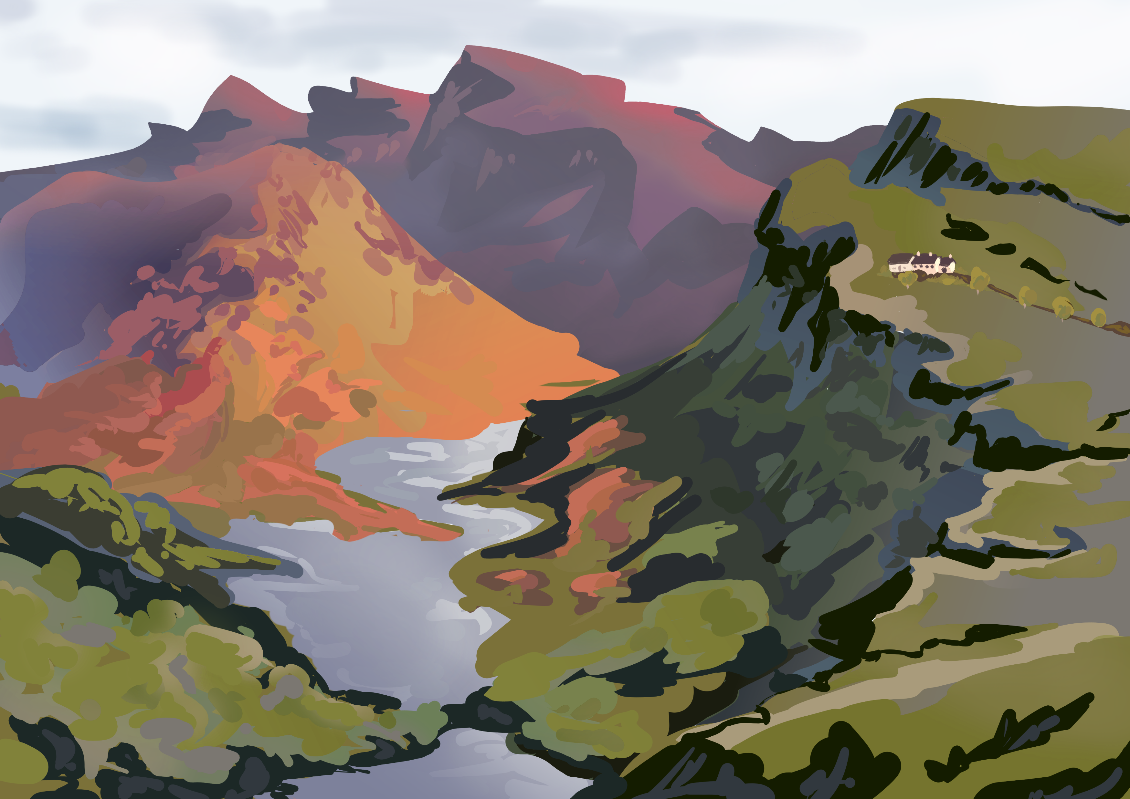
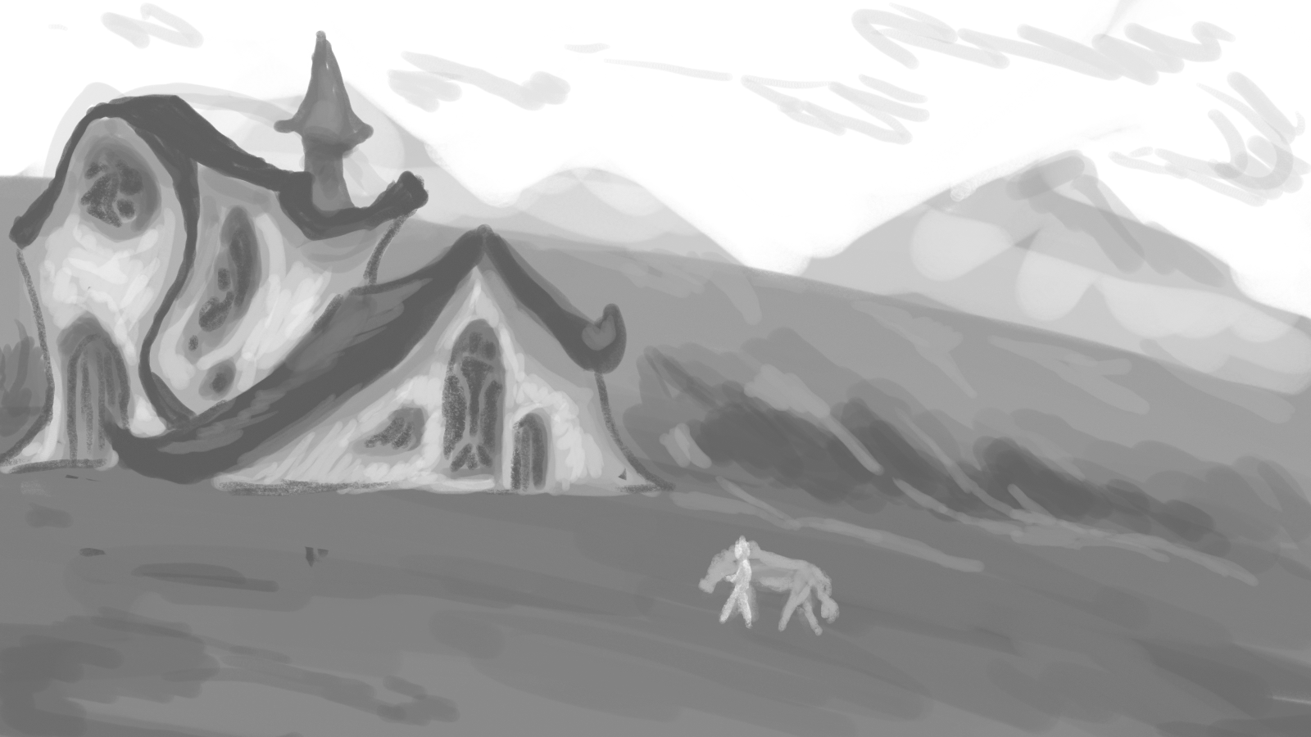
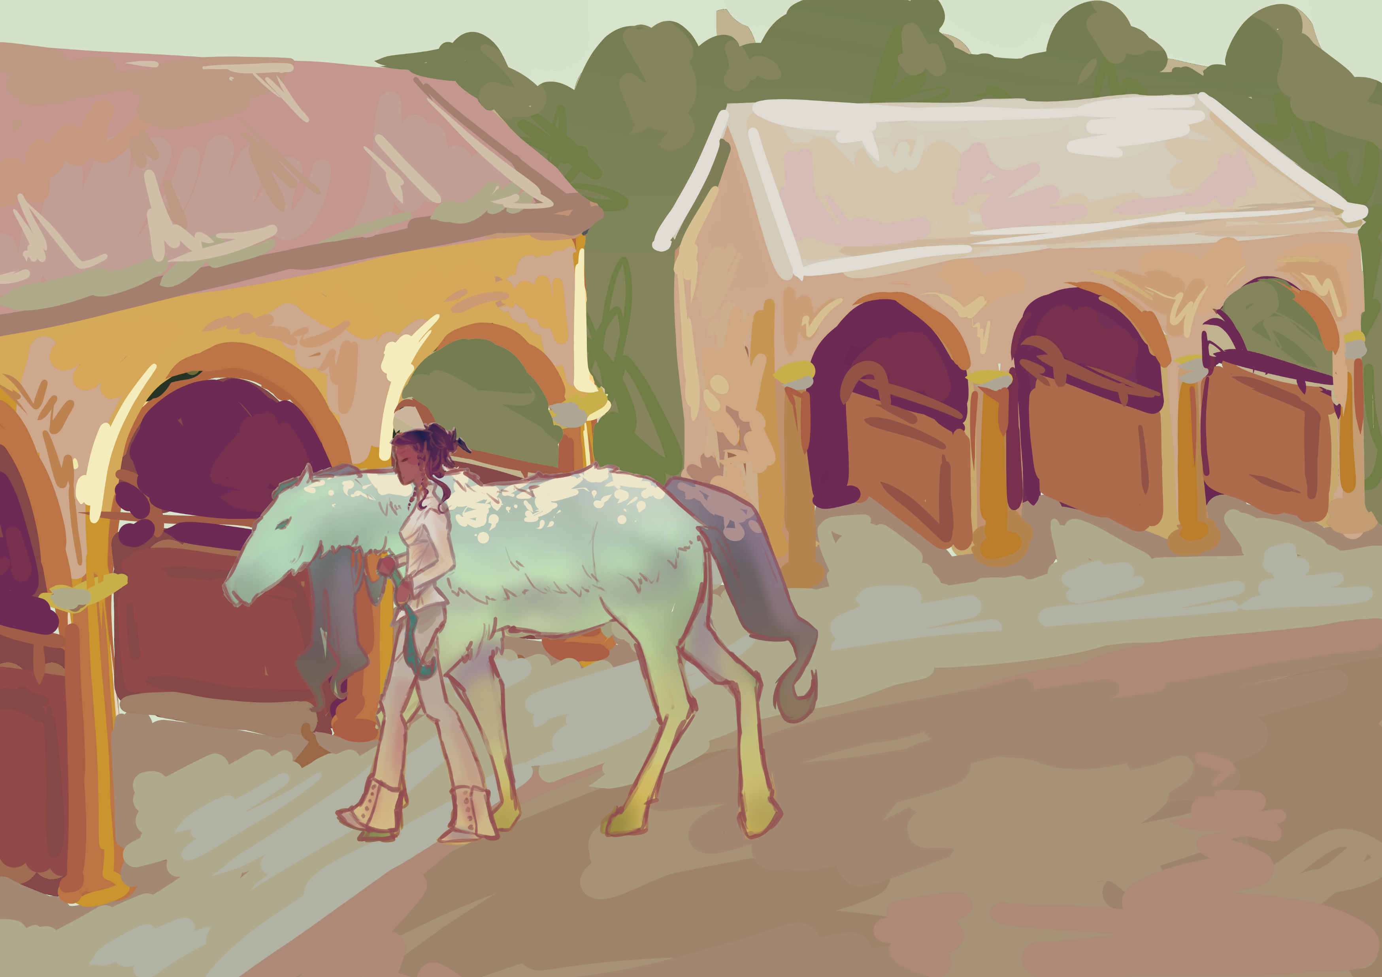
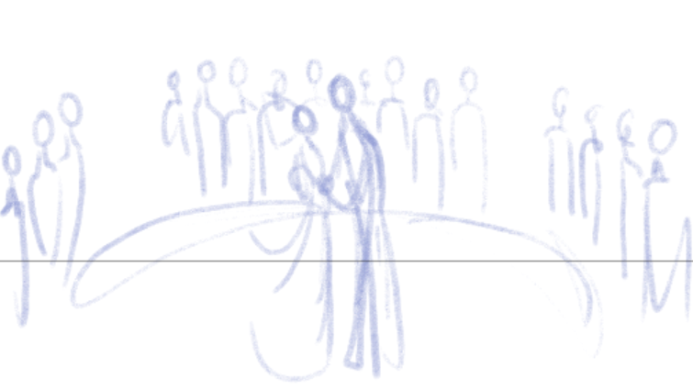
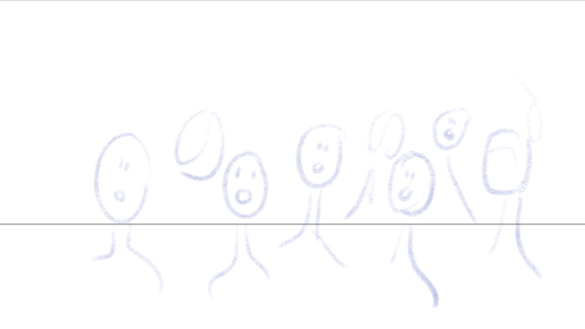
What went awry during the development of this project, and how did you adjust and overcome these challenges?

Slide 8
What will you do differently for the design and development of your next game and/or narrative project?
Don’t be so hard on myself
Lots of classes and hard to time manage, give extra time for all tasks
Schedule when to draw and when to write, differentiate
Get more playtests a lot earlier

